Slide 1
MVC

Slide 2
Overview
MVC Pattern
Relationship between components
Logical Layer in Web Application
  Model
  View
  Controller
Evolution of MVC Architecture
NO MVC
MVC Model – I
  Advantages and Limitations of MVC Model - I
MVC Model – II
  Advantages and Limitations of MVC Model - II

Slide 3
MVC Pattern
Design Pattern
  Designing a reusable software is a difficult task
  A Design pattern helps in reusable software
MVC [Model-View-Controller]
  Main concern of MVC is to separate the data (model) and the user interface (view)
  Separation is achieved by introducing an controller component
  Controller defines as how the user interface should react to a user input

Slide 4




What is MVC?
User
View
Controller
Model

Slide 5
Relationship between Components
View and Controller
  Controller is responsible for creating or selecting view
Model and View
  View depends on Model
  If a change is made to the model then there might be required to make parallel changes in the view
Model and Controller
  Controller depends on model
  If a change is made to the model then there might be required to make parallel changes in the Controller

Slide 6
Logical Layers in Web Application
Model [Business Process Layer]
View [Presentation Layer]
Controller [Control Layer]
Slide <number> of 20

Slide 7
Model
Models data and behavior behind business process
Manages Information - If Changes
Contains data and Related Functionality
Maps Real-World Entities
Performing DB Queries
Calculating Business Process
Encapsulates Domain Logic which are independent of Presentation

Slide 8
View
Obtains data from model & presents to the user
Represents Output/Input of the application
Display results of Business Logic
Free Access to Model
Reads Data from Model – Using Query Methods

Slide 9
Controller
Serves logical connection between user’s interaction and the business process
It receives and Translates input to request on model or view
Input from user and instructs the model and view to perform action
Responsible for making decision among multiple presentation
Maps the end-user action to the application response

Slide 10
Evolution of MVC Architecture
NO MVC
MVC Model 1 [Page-centric] – JSP Model 1
MVC Model 2 [Servlet-centric] – JSP Model 2

Slide 11
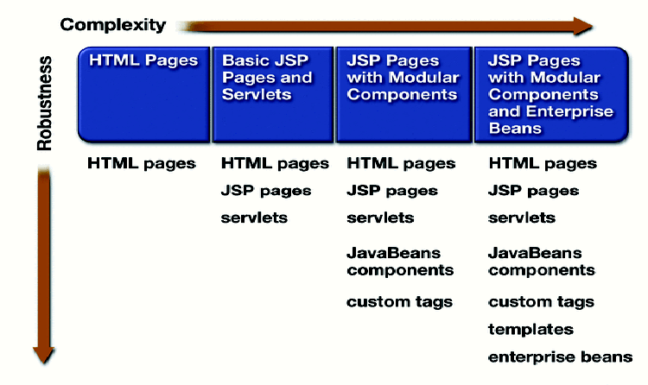
NO MVC
NO MVC
Model 1 Architecture

Slide 12
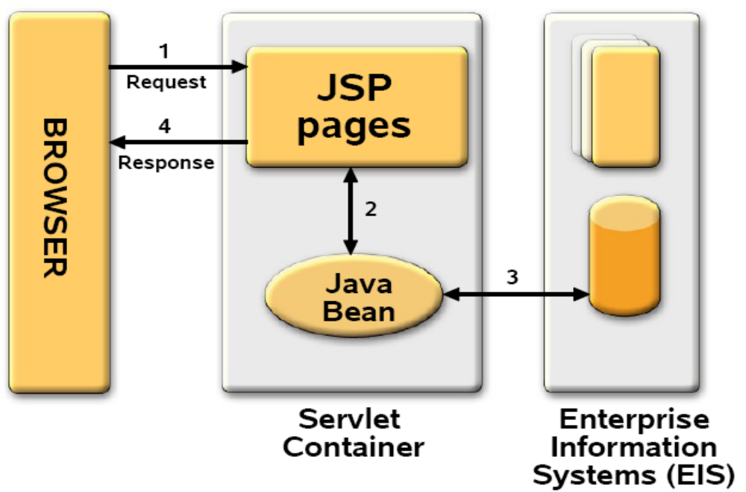
MVC Model-I

Slide 13
MVC Model - I
Composed of a series of interrelated JSP pages
JSP pages handle all aspects of the application like presentation, control, and business process
Business process logic and control decisions are hard coded inside JSP pages
Next page selection is determined by hyperlink or action of submitting a form
  <a href=“find.jsp”> Search </a>
  <form action=“find.jsp”> … </form>

Slide 14
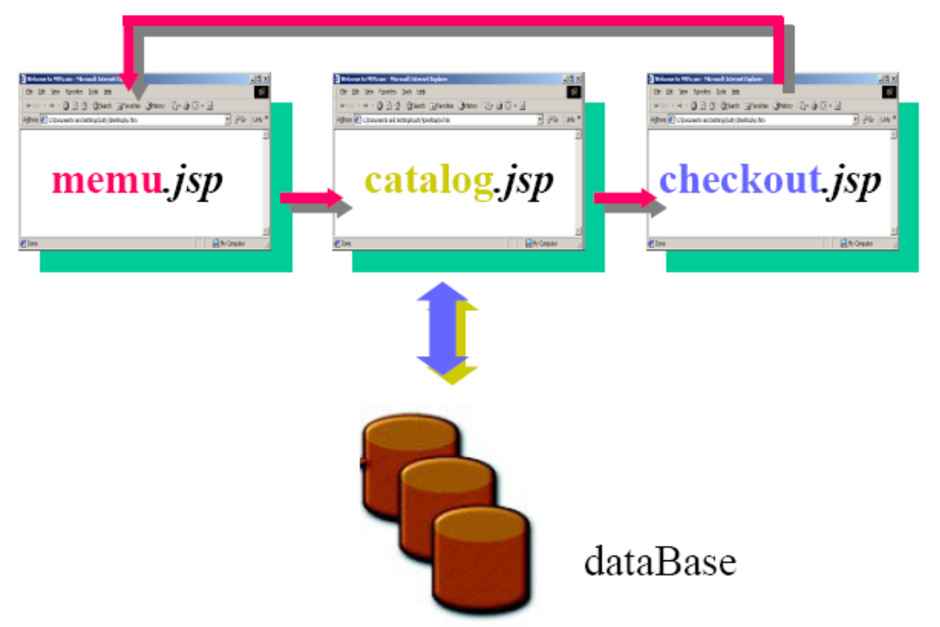
MVC Model - I
Page-centric catalog application
Slide <number> of 20

Slide 15
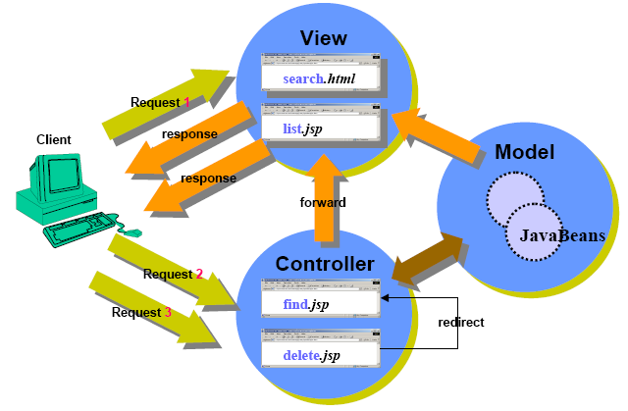
MVC Model - I
Page-centric Scenario
Slide <number> of 20

Slide 16
MVC Model - I
Advantages
  Lightweight design – for small, static application
  Suitable for small application having very simple page flow, little need for centralized security control/logging
  Separation of presentation from content
Limitations
  Navigation Problem – to change name of JSP file have to change in many location
  Difficult to maintain an application – large java code being embedded in JSP page
  Not Suitable for large and complex application

Slide 17
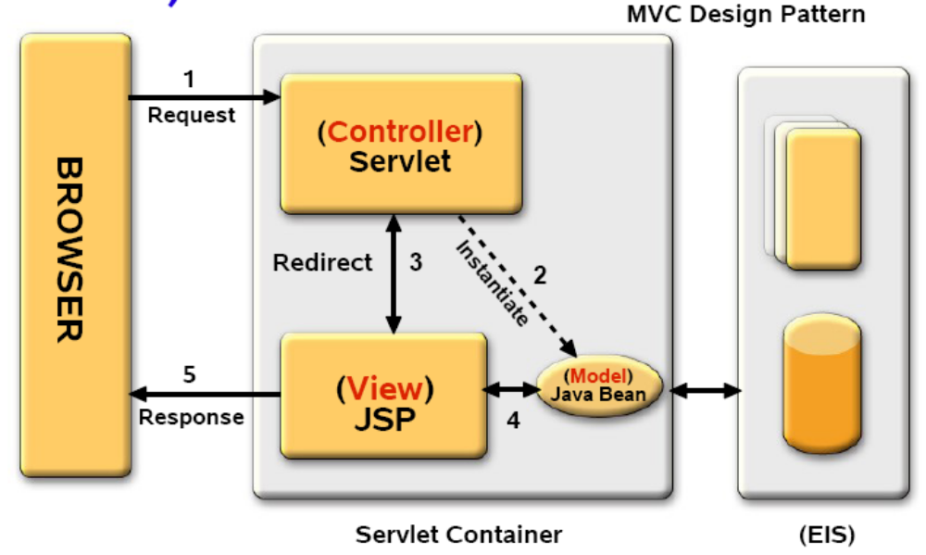
MVC Model - II

Slide 18
MVC Model - II
Use Servlet and JSP together (Model 2)
JSP pages are used only for presentation
Servlet handles initial request, partially process the data, set up beans, then forward the results to one of a number of different JSP pages
Servlet serves as a gatekeeper
  Provides common services, such as authentication authorization, login, error handling, and etc
Servlet serves as a central controller
  Act as a state machine or an event dispatcher to decide upon the appropriate logic to handle the request

Slide 19
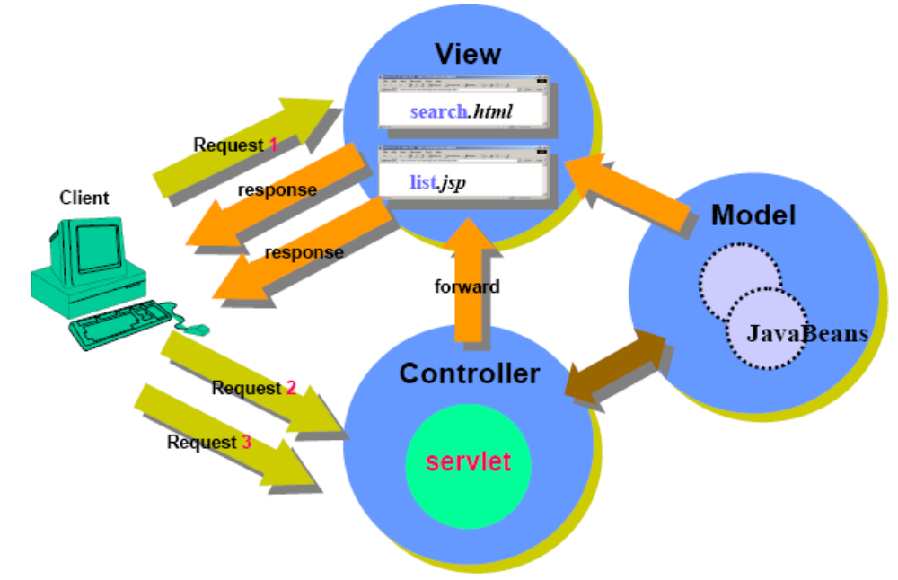
MVC Model - II
Servlet-centric Scenario

Slide 20
MVC Model - II
Advantages
  Easier to build, maintain and Extend
  Single point of control (Servlet) for security & logging
Limitations
  Increase Design Complexity

Slide 21
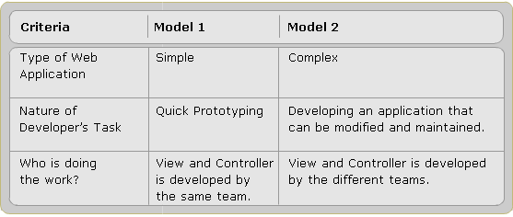
Model1 and Model2 Comparison

Slide 22
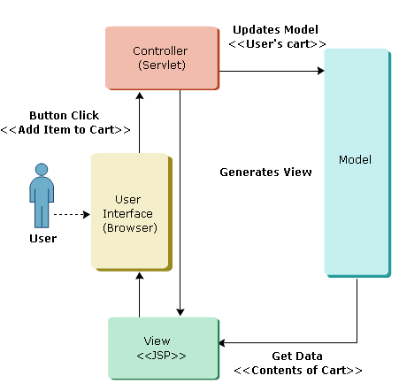
Example

Slide 23
Summary
MVC Pattern
Relationship between components
Logical Layer in Web Application
  Model
  View
  Controller
Evolution of MVC Architecture
NO MVC
MVC Model – I
  Advantages and Limitations of MVC Model - I
MVC Model – II
  Advantages and Limitations of MVC Model - II

